Slide 1


A Comparative Study of Hybrid Image and Visual Anagram Generation:
Traditional Methods vs. Diffusion Models
Siqi Yao

Slide 2
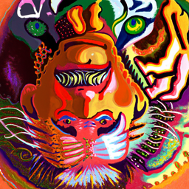
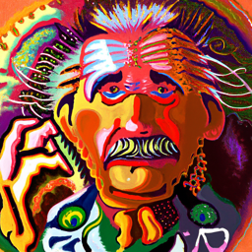

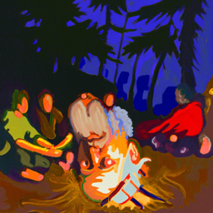
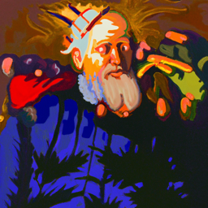
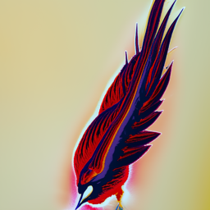
Intro
Method
Setting
Results
Visual Anagrams
Hybrid Images

Slide 3
Intro
Method
Setting
Results
Objectives
VS
Traditional Methods
Diffusion Methods
Key Aspects
Visual Quality
Semantic Control

Slide 4
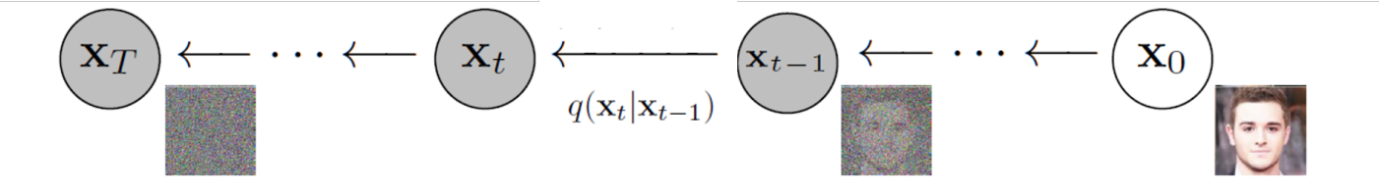
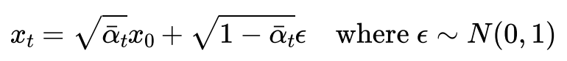
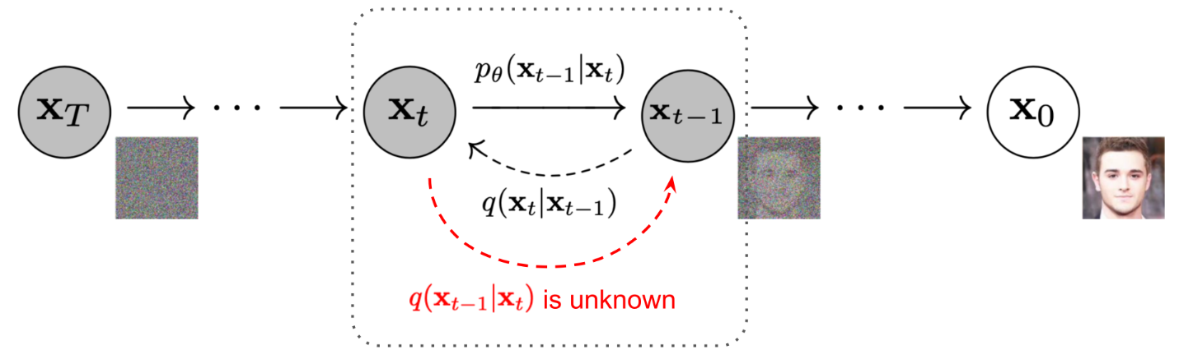
Intro
Method
Setting
Results
Diffusion Model
Add noise:
Remove noise:

Slide 5
Intro
Method
Setting
Results
Method Overview
Task | Traditional Method | Diffusion-Based Method
Hybrid Image | Pyramid Frequence Blending | Dual Prompt + Noise fusion
Visual Anagram | Manual rotation and editing | Prompt flipping + Noise averaging

Slide 6
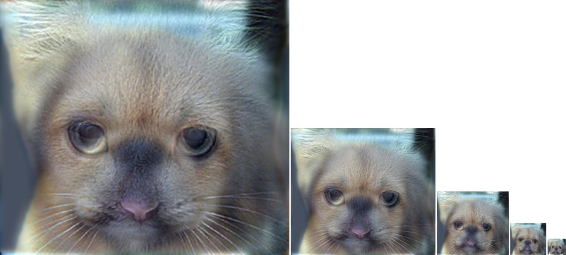
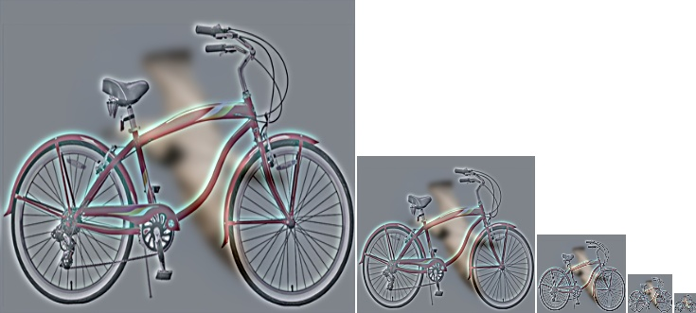
Intro
Method
Setting
Results
Hybrid Image: Pyramid Decomposition
• Can’t do semantic control.
• Requires shape compatibility.
• Abrupt fusion transitions.
• Simple, controllable, efficient.

Slide 7
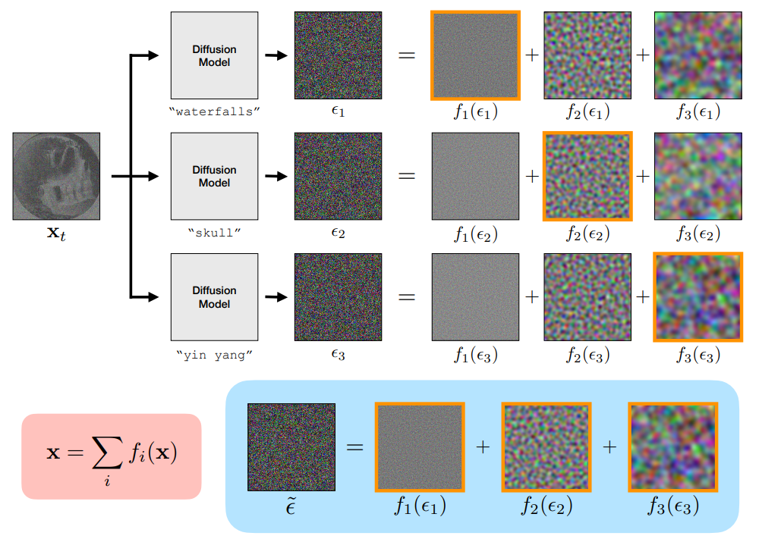
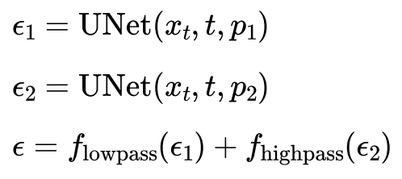
Intro
Method
Setting
Results
Hybrid Image: Diffusion Model

Slide 8
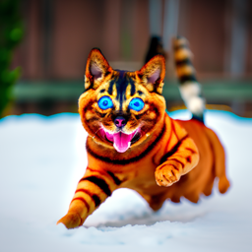
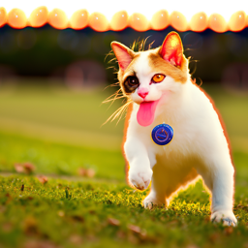
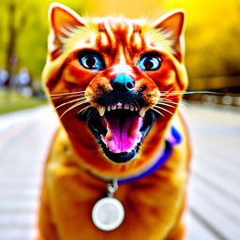
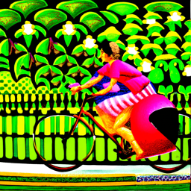
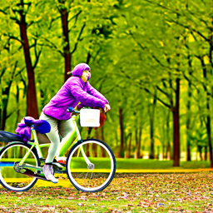
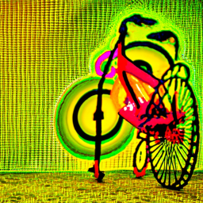
Intro
Method
Setting
Results
Results of Diffusion Model
Advantages:
• Semantic controllability via prompt.
• No need for structural compatibility.
• Smooth transitions with minimal artifacts.
• Scalable to complex, high-res, and multimodal settings.
Limitations:
• Often takes many generations to get a satisfactory result.
• Hard to precisely control spatial location of fusion.
• High computational cost-paid 9.99$ to use A100 on Google Colab.

Slide 9
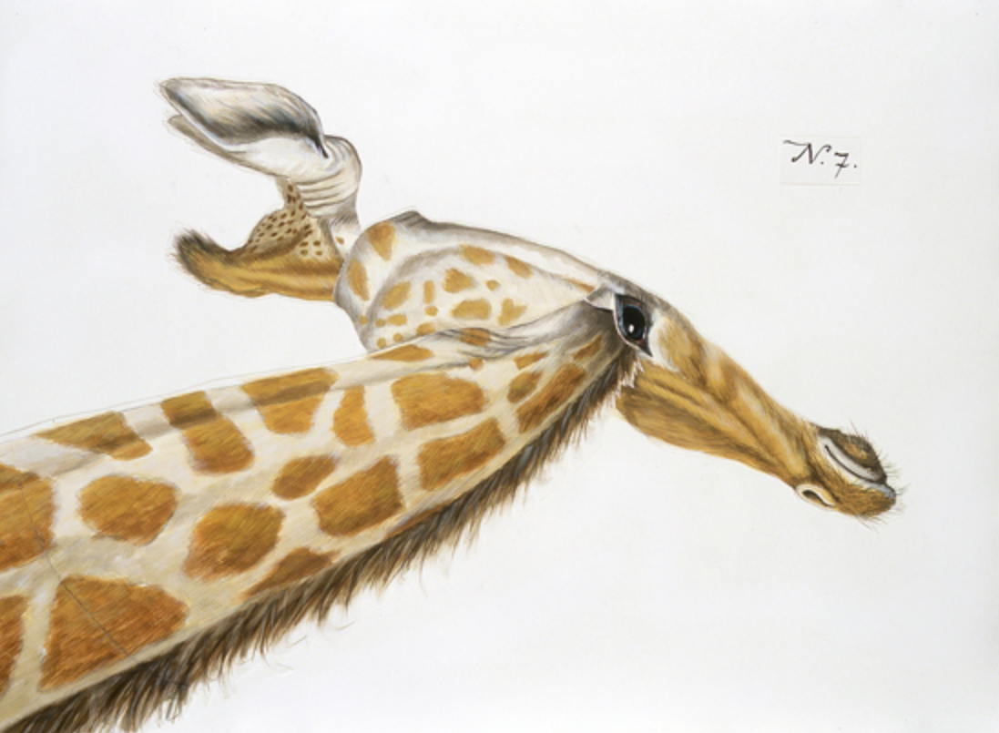
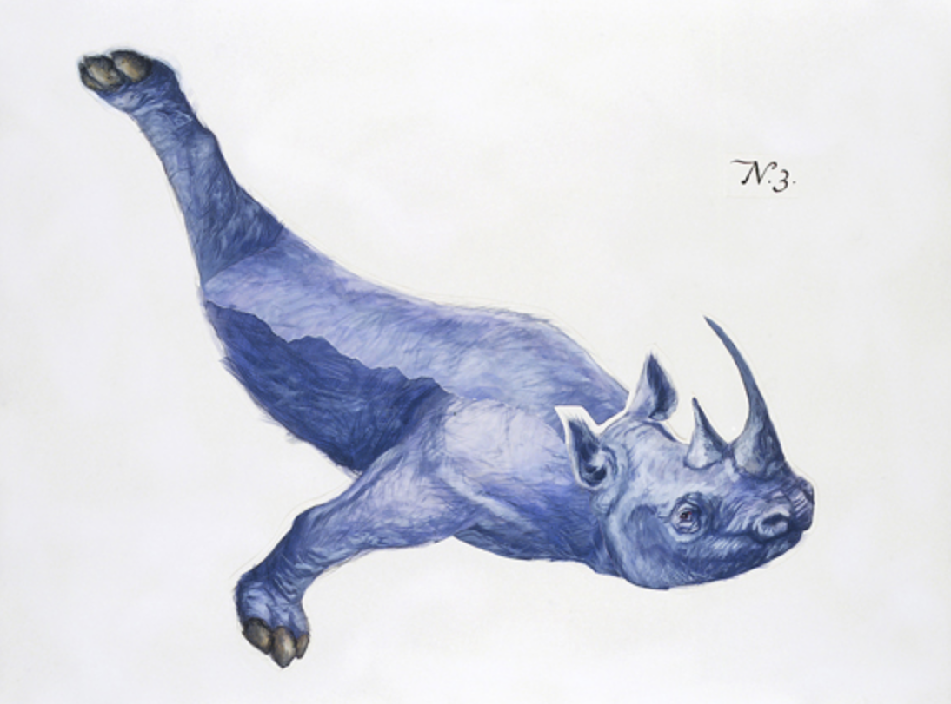
Intro
Method
Setting
Results
Visual Anagram: Manual Editing
Complicated process:
• Requires careful design
• Many manual works such as preprocessing, alignment, masking etc.
Artwork by Rupert Shrive

Slide 10
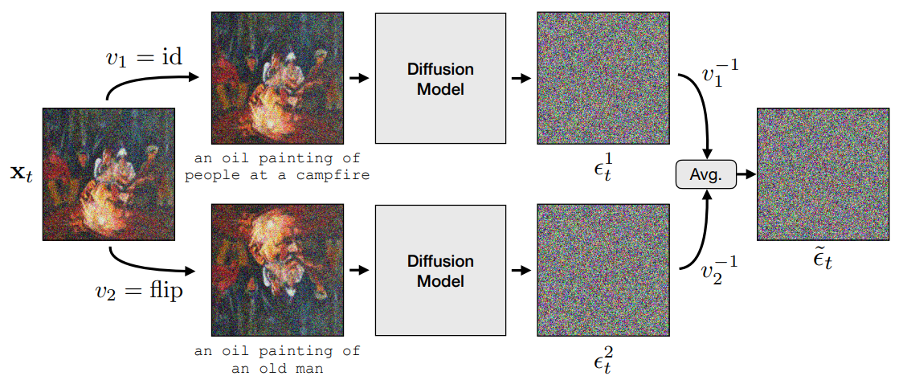
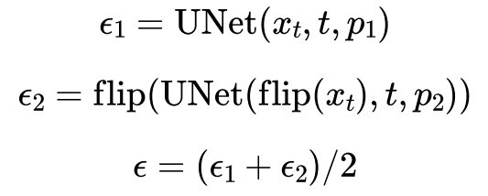
Intro
Method
Setting
Results
Visual Anagram: Diffusion Model

Slide 11
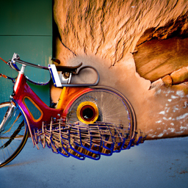
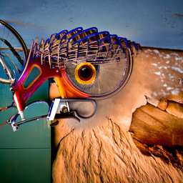
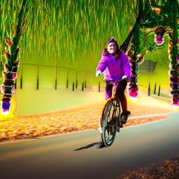
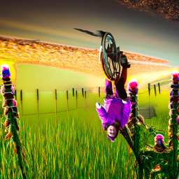
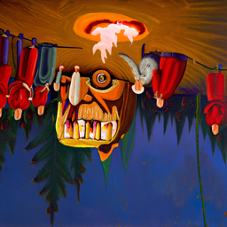
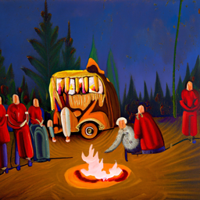
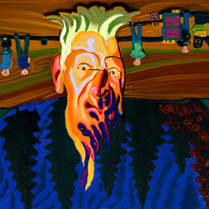
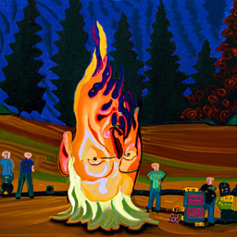
Intro
Method
Setting
Results
Results of Diffusion Model
Advantages:
• Strong automation capability.
• Flexible semantic control.
• Natural structural fusion.
• High scalability.
Limitations:
• Prompt imbalance.
• Sensitivity to parameter tuning.
• High computational cost.

Slide 12
Intro
Method
Setting
Results
Experimental Settings
1
2
3
Prompt Embedding
Model
Dataset
DeepFloyd IF from HuggingFace.
T5 text encoder from HuggingFace.
CIFAR-10.
4
5
CFG
Resouce
Classifier-free guidance is used in the denoising process.
A100 from Google Colab.

Slide 13
Intro
Method
Setting
Results
Semantic Control Evaluation Using CLIP Similarity Score
a photo of a bird
an oil painting of an old man
an oil painting of people around a campfire
a photo of a bicycle
0.3003
0.2736
0.2513
0.3608
0.2515
0.2130
0.2819
0.3264
A score > 0.25 suggests a strong semantic aligment.

Slide 14
Intro
Method
Setting
Results
Thank You!
Website: yaosiqi2003.github.io

